Slide 1

Website Phishing detection Machine learning
Congratulations!!! You are the lucky winner of $10000000!!!!
https://storyset.com/web
Orea Kicaj

Slide 2

Why?
Phishing is a way to lure victims into malicious web pages, where malware codes are hidden. This way the attacker can intrude the enterprise network, evading firewalls.
Phishing attack continues to pose a serious risk for web users and annoying threat within the field of electronic commerce.
Therefore, it is important to detect phishing URLs and prevent users from visiting them.
https://storyset.com/web

Slide 3

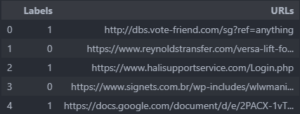
Brief steps
Dealing with a Dataset that contains URL link
-Phishtank
“Engineering” new Features from the URL column
- extracting more information [Url based and HTML & JS based]
Creating a new dataset with the added features
Try ML algorithms for the new dataset
See how important are the created features for Feature Selection
Observing and comparing the results of ML models
Conclude with choosing the algorithm that works best for the new dataset.

Slide 4
Feature engineering
URL Based
URL length
URL depth
Digits count
Domain name
Domain Dots count
Domain length
Presence of other Features :
- HTTP/HTTPS presence in Domain
- Hyphen presence in URL Domain
- URL @ symbol presence
- Non ASCII characters in URL
- IP address presence in URL
- Transport layer security (TLS) presence in URL
By doing feature engineering I also make sure that data will be clean 🧹 and ready to use since the beginning.
HTML & JS Based
Disabled right click
Number of web forwards
Window popup existance
Hidden Iframe redirection

Slide 5
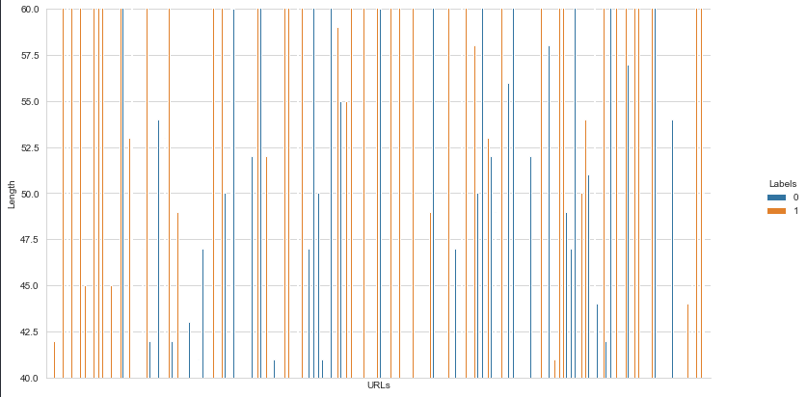
Urls Length
I limited the graph. from 40 to 60, because that's where I noticed some difference.
Legitimate URLs start to reduce after 48 and almost completely disappear after 60.
Fishing for Length > 60
Legitimate for Length <= 48
Suspicious for the others in-between

Slide 6
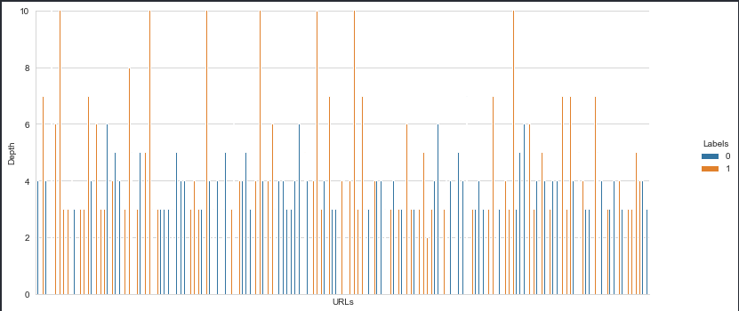
Urls Depth Depth counted from the number of slashes. ‘/’
Following the same steps as the length above, it is even more noticeable that Legitimate URLs are reduced after 3 and almost not there after 4.
Fishing for Depth > 4
Legitimate for Length <= 3
Suspicious for the others in-between

Slide 7
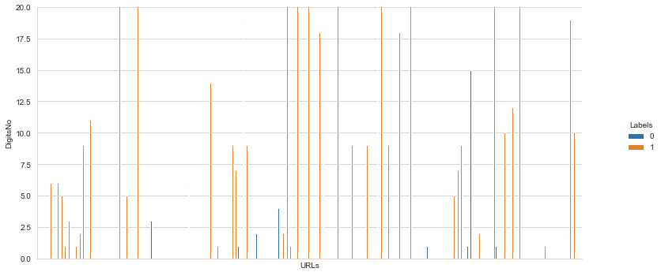
Digits count
Noticed that Phishing URLs have a pretty high number of digits
Fishing for Count > 4
Legitimate for Length <= 2
Suspicious for the others in-between

Slide 8
Redirect position
I have taken in account that a Legitimate URL should start with HTTPS://
The existence of “//” within the URL path means that the user will be redirected to another website.
So, in this case the "//" position should be only after HTTPS. Every other location apart from after the S returns a Phishing value.
URL_RedirectPosition = urlData['URLs'].str.rfind('//')
URL_RedirectPosition = URL_RedirectPosition.apply(lambda x: Fishing if x > 7 or x < 6
else Legitimate)

Slide 9
Domain name
We need to extract the name of the Domain to find out other related features
The domain name is extracted with the help of Regex
Domain = urlData['URLs'].str.extract(r'^https?://(.*?)/', expand=False)
Domain = Domain.str.replace(r'www.', '', regex=True)

Slide 10
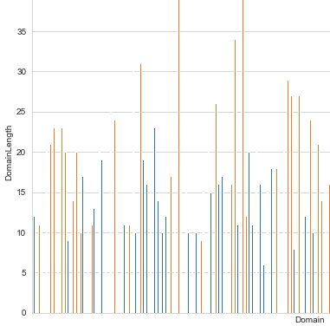
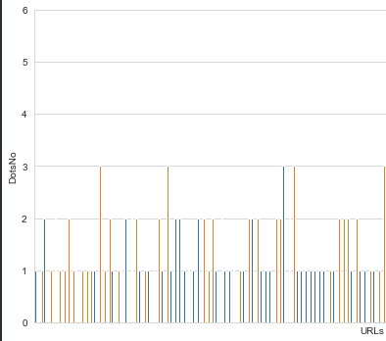
Domain features
Domain Length
Domain dots count
Fishing for Length > 18 or < 7
Legitimate for Length <= 12
Suspicious for the others in - between
Fishing for Dots count x > 2
Legitimate for Dots count <= 1
Suspicious for the others in - between

Slide 11
Presence of other features in URLs
In most of the URLs there are characters, or numbers and strings that by their presence, define if it's a fishing URL or not.
I have taken into consideration:
HTTP/HTTPS presence in Domain
Hyphen ‘-’ presence in URL Domain
URL @ symbol presence
Non ASCII characters in URL
IP address presence in URL
Transport layer security (TLS) presence in URL

Slide 12
HTML and JS Based
BeautifulSoup Library is used to scrape available (legal) data from the websites
From there HTML and JS features can be extracted.
Disabled right click
Number of web forwards
Window popup existence
Hidden Iframe redirection
Percentage of the same URLs(Domain)

Slide 13
HTML and JS Based
BeautifulSoup Library is used to scrape available (legal) data from the websites
From there HTML and JS features can be extracted.
Disabled right click
Is done so that users cannot view and save the webpage source code
Number of web forwards
Window popup existence
Hidden Iframe redirection
Percentage of the same URLs(Domain)

Slide 14
HTML and JS Based
BeautifulSoup Library is used to scrape available (legal) data from the websites
From there HTML and JS features can be extracted.
Disabled right click
Number of web forwards
Legitimate websites do not need to be redirected too many times. Phishers use redirecting to hide other webpages within.
Window popup existence
Hidden Iframe redirection
Percentage of the same URLs(Domain)

Slide 15
HTML and JS Based
BeautifulSoup Library is used to scrape available (legal) data from the websites
From there HTML and JS features can be extracted.
Disabled right click
Number of web forwards
Window popup existence
It is common practice (also aesthetically) that webpages don’t include pop up windows, except for ads. If there is any, it is counted as a phishing website
Hidden Iframe redirection
Percentage of the same URLs(Domain)

Slide 16
HTML and JS Based
BeautifulSoup Library is used to scrape available (legal) data from the websites
From there HTML and JS features can be extracted.
Disabled right click
Number of web forwards
Window popup existence
Hidden Iframe redirection
Iframe as a HTML tag is used to display additional webpages, from the current one. So, if it is hidden it means that they don’t want to show the hidden webpages within.
Percentage of the same URLs(Domain)

Slide 17
HTML and JS Based
BeautifulSoup Library is used to scrape available (legal) data from the websites
From there HTML and JS features can be extracted.
Disabled right click
Number of web forwards
Window popup existence
Hidden Iframe redirection
Percentage of the same URLs(Domain)
- Personal favorite
Fishers put 'links' within the pages (hidden or not) to make the user redirect from the mimicked website to the ones they want.
Knowing this, I can check if the % of these other links is low in comparison the one we are at it is possibly a Fishing website.

Slide 18
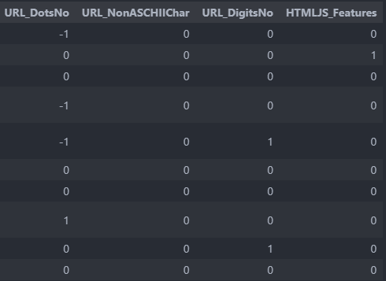
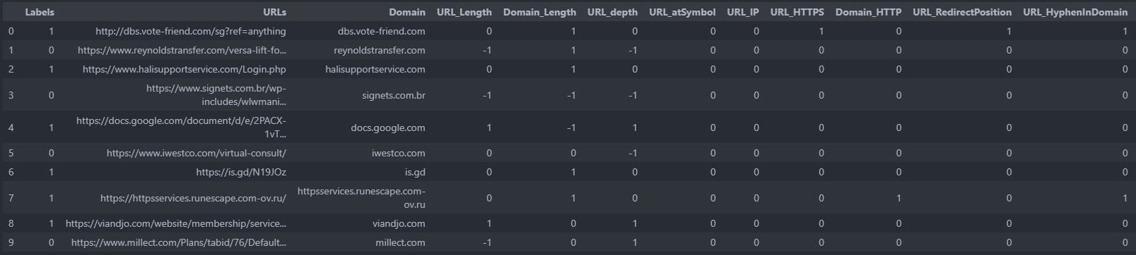
The new dataset

Slide 19
ML algorithms to try
Decision Tree model
Random Forest Classifier
XGBoost Classifier
KNN Classifier
Autoencoder Neural Network
Recurrent Neural Networks

Slide 20
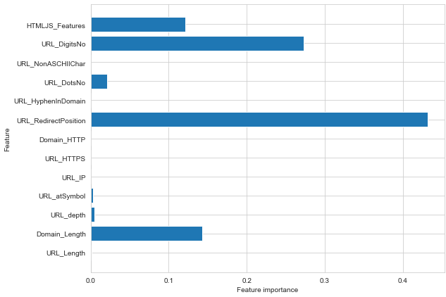
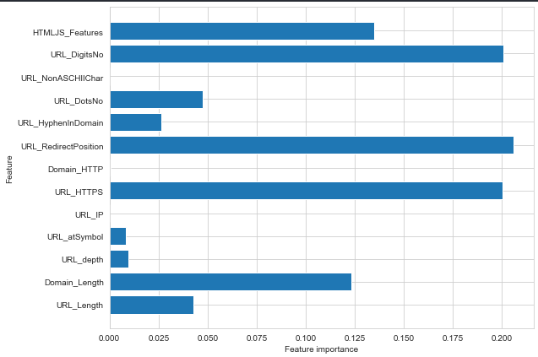
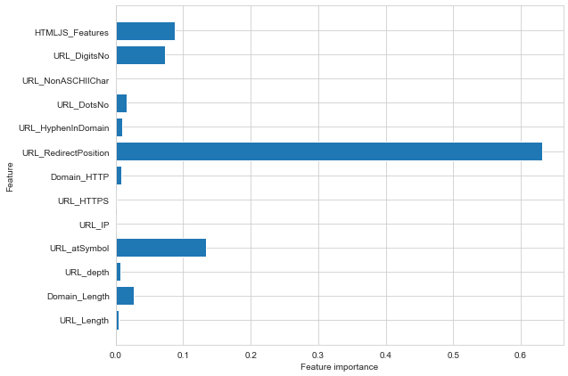
Feature importance
Decision Tree
Random Forest
XGBoost
Feature importance

Slide 21
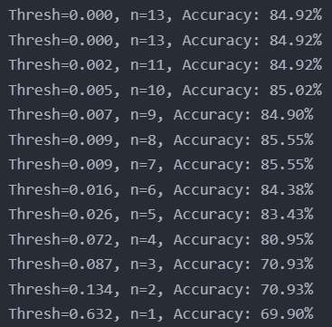
Lets check how to use feature importance for feature selection (XGBoost)
Fit model using each importance as a threshold
Select features using threshold
Train model
Evaluate model

Slide 22

Observation
After testing and training for each model, I store the performance results to compare later on.
The ANN Model was left behind in comparison with the other models
(~ 0.4 accuracy), so I didn’t store its results.
Test/Train Accuracy
Test/Train Precision
Test/Train Recall
Test/Train F1
https://storyset.com/web

Slide 23
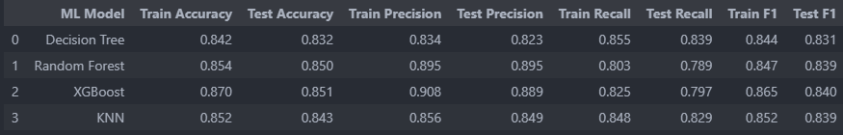
Stored results
We can see that the overall better model for this dataset is XGBoost

Slide 24

Thank you!

